Slide 1
Support Vector Machines (SVM)
Part 1
http://www.machinelab.org

Slide 2
An Illustrative Example
Wealth
Mortgage loan application
= Approve
= Reject
Age

Slide 3
Optimal Hyperplane
Wealth
Age

Slide 4
An Illustrative Example
weight
height

Slide 5
Generalization
weight
height
What is a good classifier?

Slide 6
Maximizing Margin
weight
height
Good generalization = Maximizing Margin.

Slide 7
SVM
SVM was originally proposed by Boser, Guyon and Vapnik in 1992 and gained increasing popularity in late 1990s.
SVM are currently among the best performers for a number of classification tasks ranging from text to genomic data.
SVM techniques have been extended to a number of tasks:
  handwriting recognition
  face detection
  text categorization
  bio-informatics
  ……………

Slide 8
SVM Models
Linear SVM

Slide 9
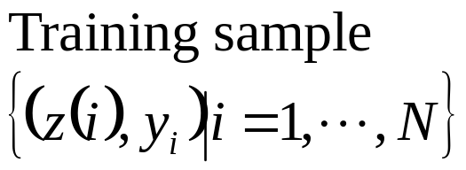


SVM Concepts

Slide 10

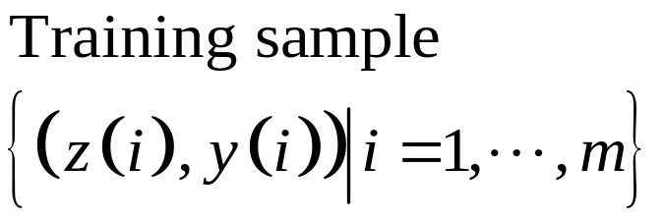
Hyperplane
Optimal hyperplane

Slide 11
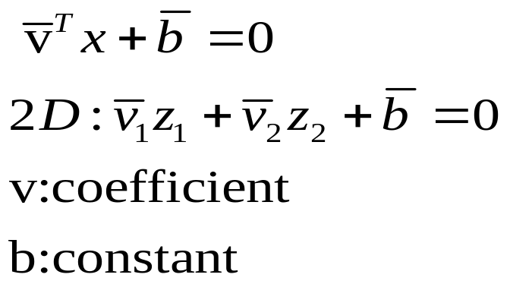
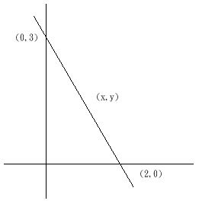
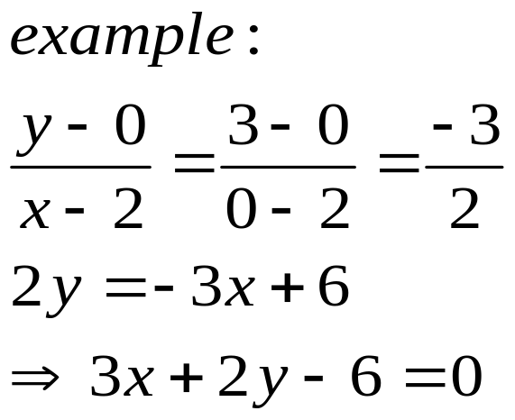
Hyperplane

Slide 12
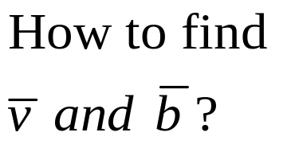
SVM Model

Slide 13
Linearly Separable

Slide 14
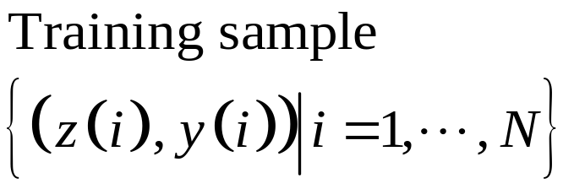
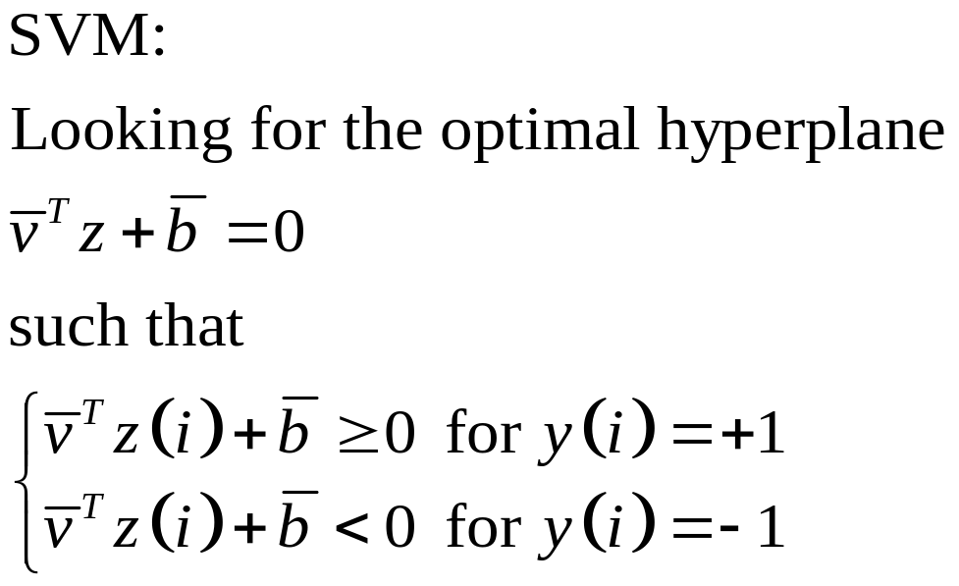
Linearly Separable
Optimal hyperplane

Slide 15
Linearly Separable
Optimal hyperplane

Slide 16
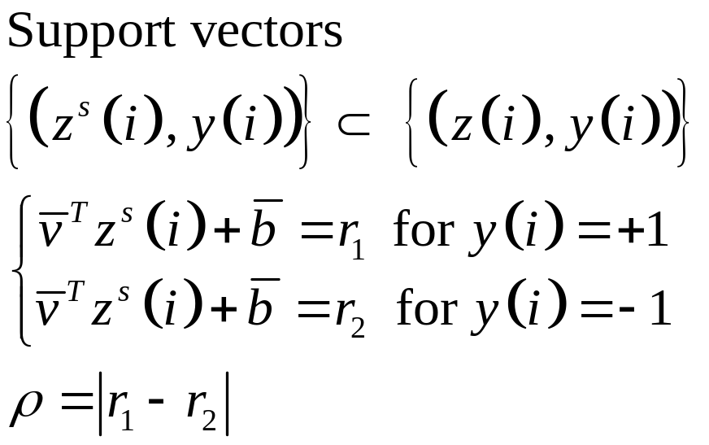

Linearly Separable
Optimal hyperplane
Support vectors

Slide 17
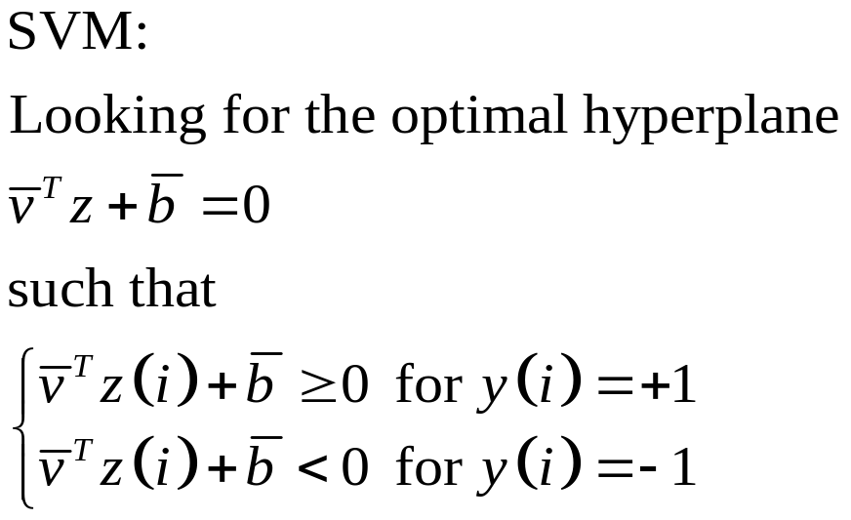
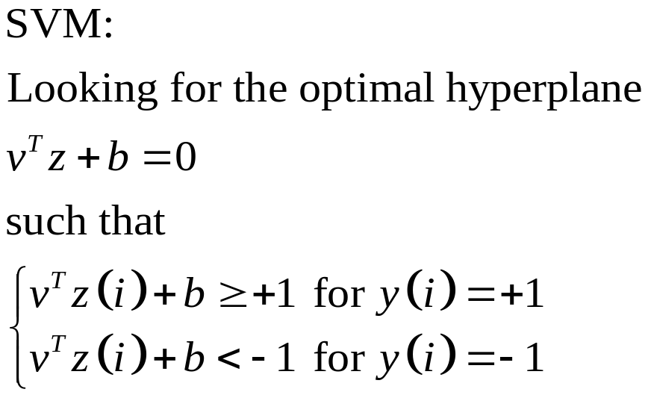
Linearly Separable

Slide 18
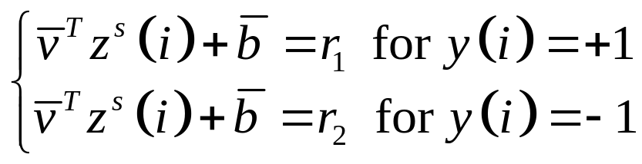

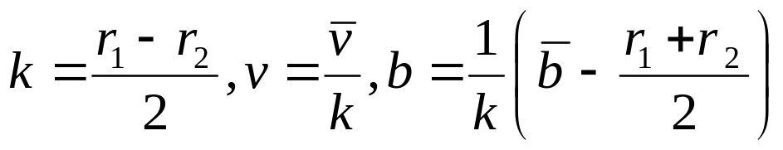

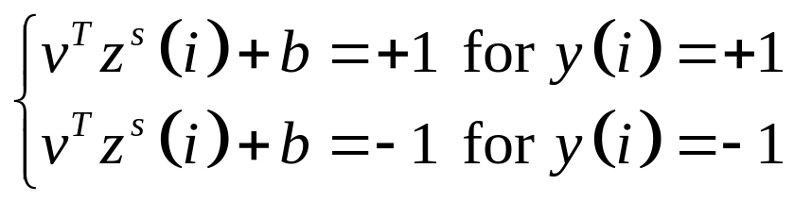
Linearly Separable

Slide 19
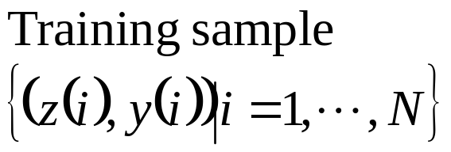

Linearly Separable

Slide 20
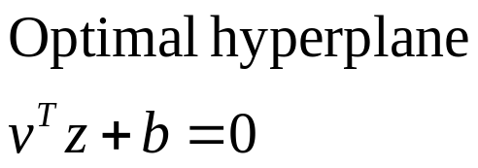
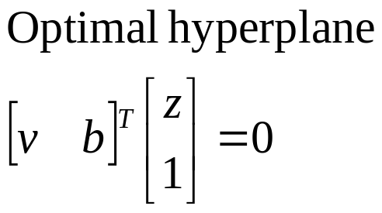
Linearly Separable

Slide 21
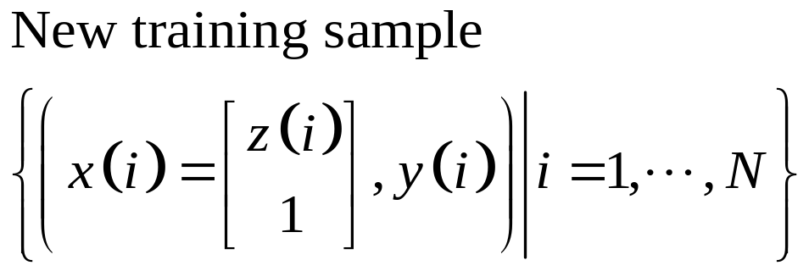
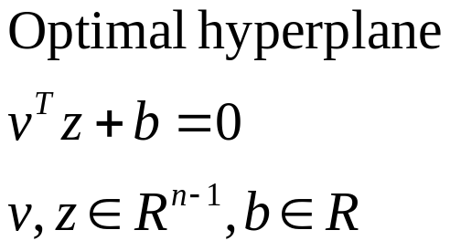
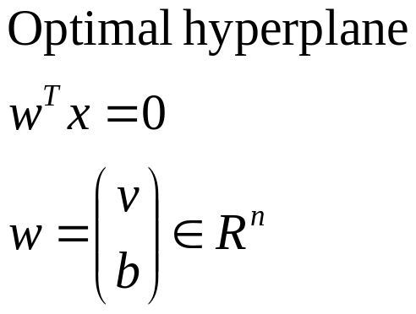
Some Definitions

Slide 22
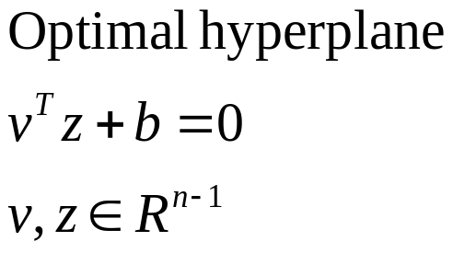
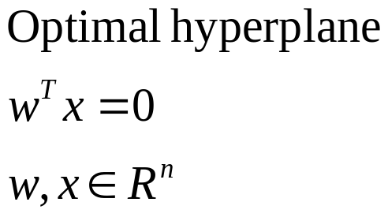
Some Definitions

Slide 23

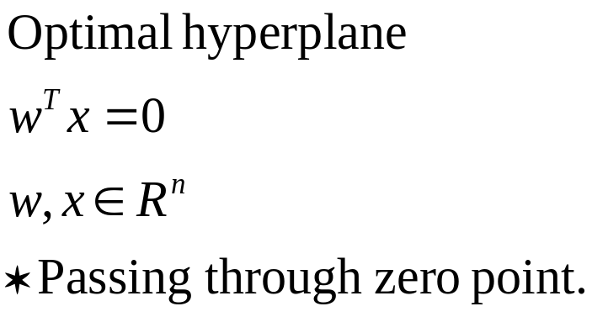
Some Definitions

Slide 24
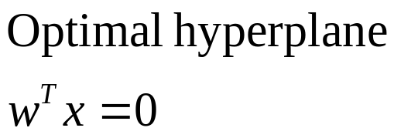
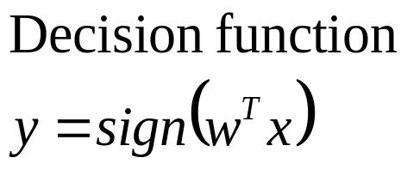
Linearly Separable

Slide 25


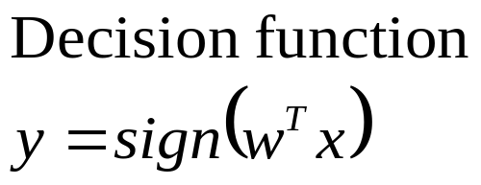






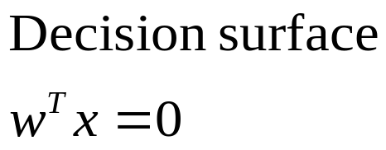


Mapping to NNs

Slide 26


Linearly Separable
Support Vectors

Slide 27
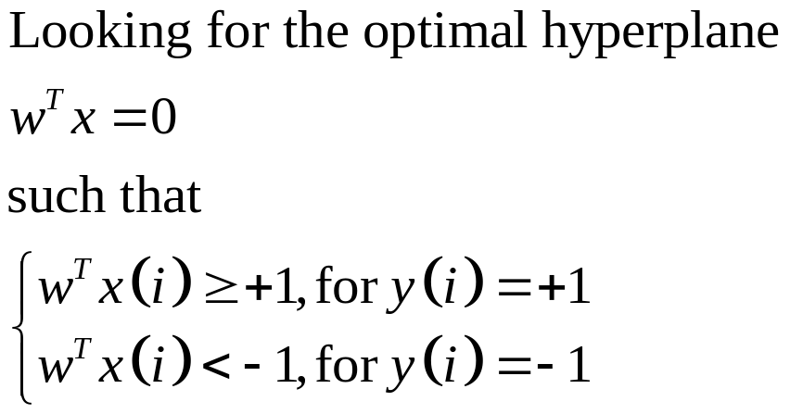
Linearly Separable

Slide 28
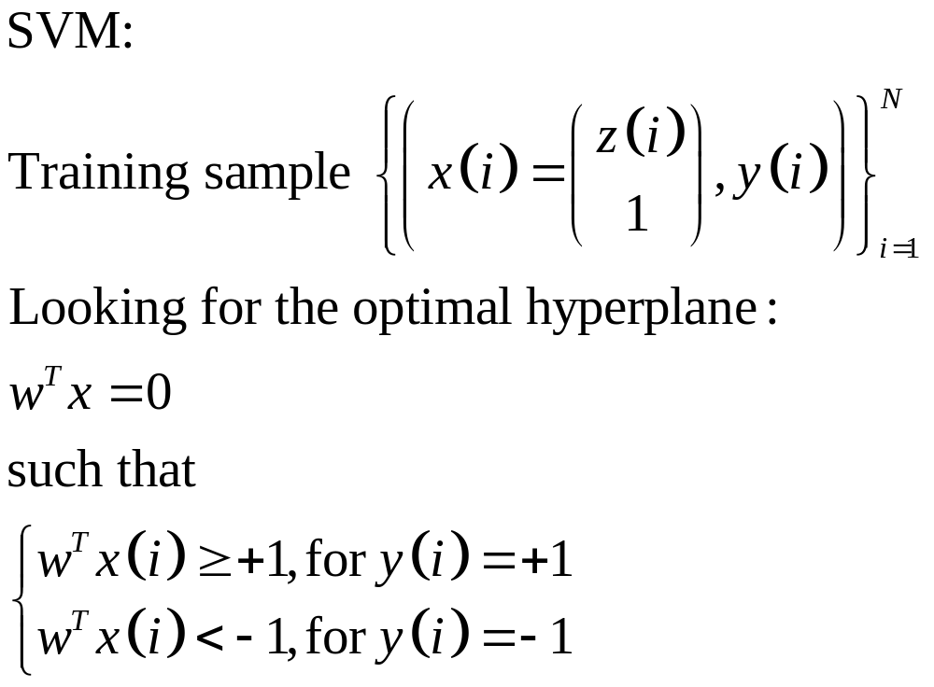
Linearly Separable

Slide 29
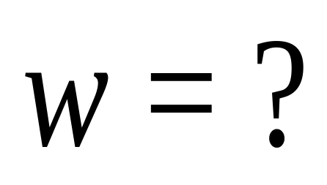


Linearly Separable

Slide 30

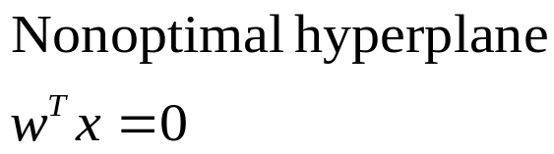
Linearly Separable

Slide 31

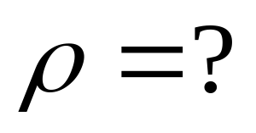
Linearly Separable

Slide 32


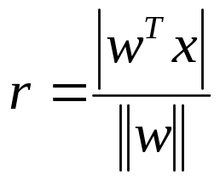
Linearly Separable

Slide 33
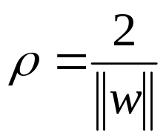
Linearly Separable

Slide 34


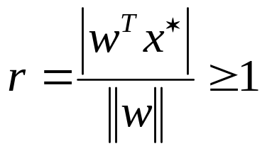
Linearly Separable

Slide 35
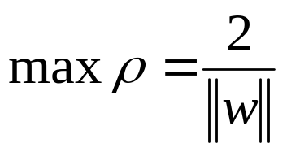
Linearly Separable

Slide 36
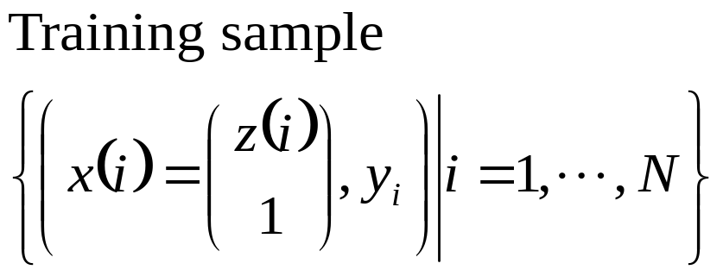
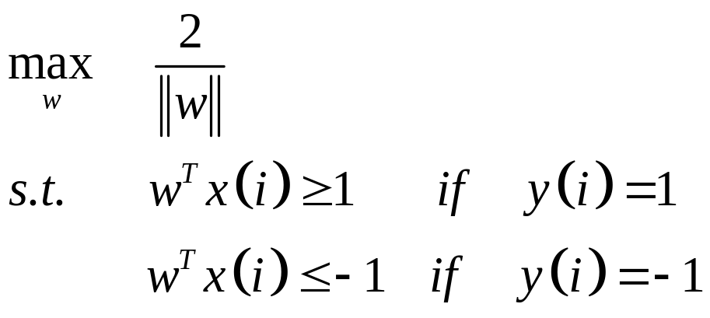
Linearly Separable

Slide 37
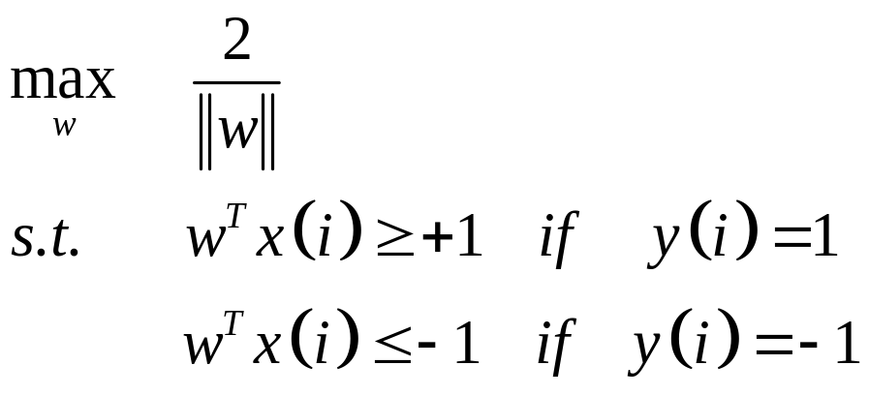
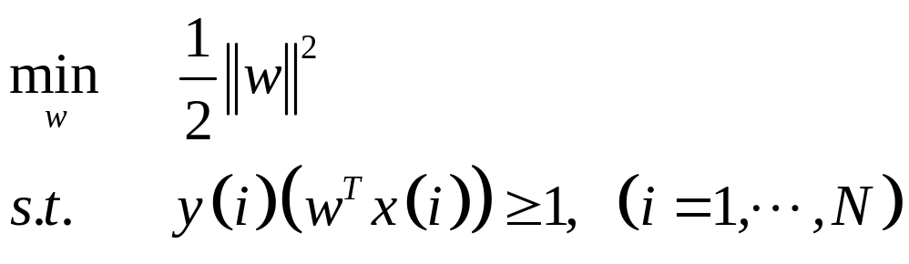
Linearly Separable

Slide 38
Linearly Separable

Slide 39
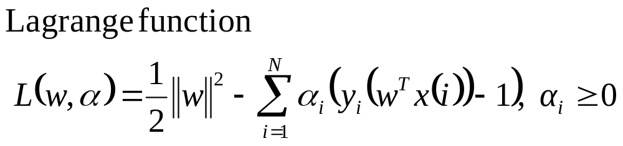
Linearly Separable

Slide 40
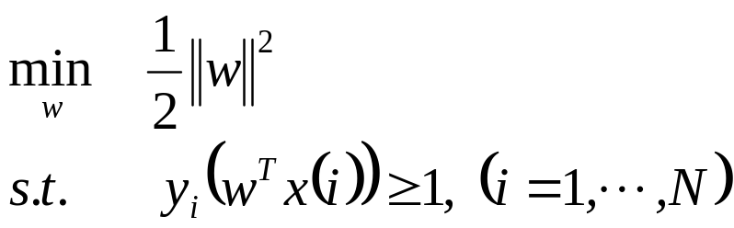

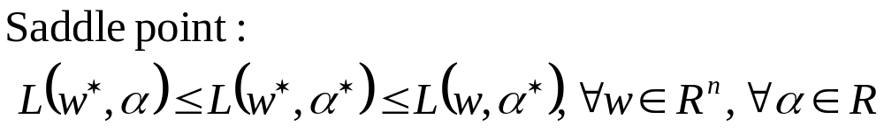
Linearly Separable

Slide 41
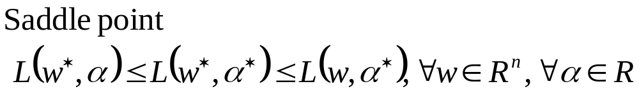
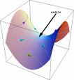
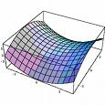
Linearly Separable

Slide 42
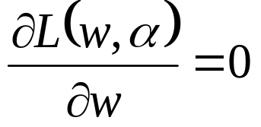
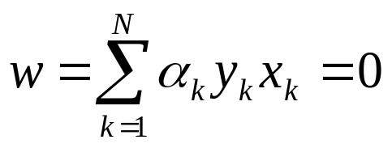


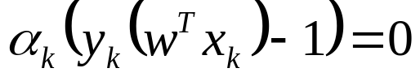
Linearly Separable

Slide 43
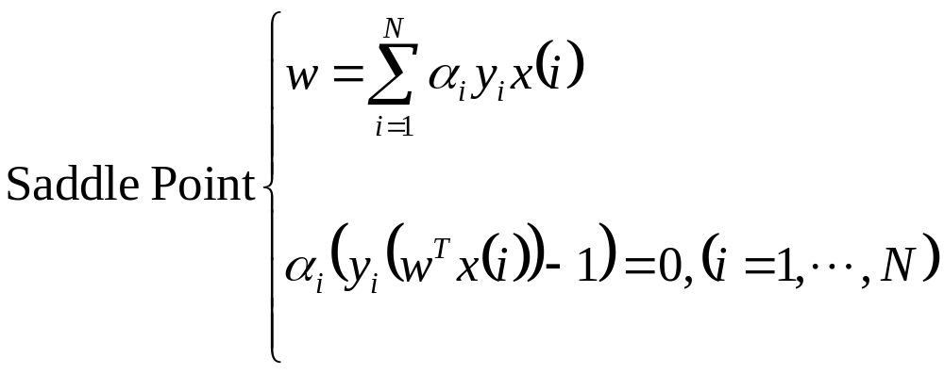
Linearly Separable

Slide 44


Linearly Separable

Slide 45



Linear Separable

Slide 46


Linearly Separable

Slide 47



Linearly Separable

Slide 48




Linearly Separable

Slide 49
Applications

Slide 50

Computational Biology
Protein remote homology detection
Classification of genes and proteins
Prediction along the DNA or protein strand
Micorarray gene expression analysis
……
W. S. Noble, Support vector machine applications in computational biology, www.gs.washington.edu/noble/name-change.html

Slide 51

Handwriting Recognition
M. M. Adankon, M. Cheriet, Model selection for the LS-SVM Application to handwriting recognition, Pattern Recognition, 42(2009) 3264-3270

Slide 52


Brain Computer Interface
Y. Li, C. Guan, H. Li, Z. Chin, A self-training semi-supervised SVM algorithm and its application in an EEG-based brain computer interface speller system, Pattern Recognition Letters 29(2008) 1285-1294

Slide 53

Intrusion Detection
W. H. Chen, S. H. Hsu, H. P. Shen, Application of SVM and ANN for intrusion detection, Computer& Operations Research, 32(2005) 2617-2634

Slide 54


Face Detection

Slide 55


Face Detection
E. Osuna, R. Freund, and F. Girosi, Training Support Vector Machines : an Application to Face Dectection, 1997

Slide 56


Face Detection
E. Osuna, R. Freund, and F. Girosi, Training Support Vector Machines : an Application to Face Dectection, 1997

